Slide 1
Teaching Strategies Gold

Slide 2
New Online Assessment System Training
Objectives
Participants will demonstrate knowledge
of the Teaching Strategies Gold Assessment structure by actively working in small groups to understand the new objectives & progression of learning.
2. Students will participate as a group in locating the tools & information available online and entering required data.
Teaching Strategies GOLD

Slide 5
Finalizing
Checkpoints
Ask Questions
Take
Action
Collect
Data
Interpret Data
Summarize
Communicate
Plan
IT IS A PROCESS
NOT AN EVENT
Notes:
Obs & Doc HOW-writing obs notes; portfolios with art, work, writing, samples; photographs; gathering info for F When –should be a reg part of day-build time into each day to observe and doc C dev. What-Detailed , objective obs notes to help you make informed, accurate decisions about C’s dev over time. -Descriptions of Actions, quotations, Facial expressions, creations –remember just the facts without interpretations How Many-no rule-some only 1 others particularly for those less visible-may need 2 or 3 pieces to be confident about dec. Portfolios- may want to take picture of some work for portfolio so is less cumberson- Use Objectives for D&L-writing samples, Photographs need a brief description about what C tells you about thier work, art work should document progress step2-gr arrow-analyze and respond by considering skills related to specific objs & then scaffolding their lrng Use Obj for D&L , doc, & checkpoints
Red arrow-3rd step-To evaluate you will use Obj for D&L, Doc., Checkpoints You will need to decide what level the Chas reached on the obj. Evaluate C’s skills by comaparing them to research-based indicator of L&D-Is this C making progress/How do this c’s skills and Beh compare to most C in this age gp? PRACTICE
Step 4- Blue-Summarize, plan for short and long term & communicate to plan meaningful experiences & share C’s strengths w/ others. how can I summarize what I know yo plan and communicate with others Use OBj for D&L, DOC, Ckpts, weekly planning form, F conf form Weekly team plan is informal but done regularly-daily planning is your reflection on the day went and making necessary adjustments along the way.

Slide 6
The Observation Cycle
Ask
Questions
Build Relationships
Teach Responsibly
Curiosity
Watch, Listen,
& Record
Respond
Understand
Development
Reflect
Ongoing Every Day-Every Week-Every Month
Resources: Jablon, Judy R; Dombro, Amy L; Dichtelmiller, Margo L. (2007). The Power of Observation. Washington DC: Teaching Strategies.
Stetson. Charlotte; Jablon, Judy; Dombro, Amy L; (2009). Observation: The Key to Responsive Teaching . Washington DC: Teaching Strategies.
Notes:
Observing with purpose and intention requires you to slow your pace & let yourself be curious about children. Maintaining an attitude of wonder about children means asking questions like “what is this child like”, & How does this child respond in certain situations. Relationships with children & their families are strengthened through observing and connecting you to them. A R with C and F is a prerequisite to helping a C to grow & learn. Respectful, sensitive, nurturing R’s require this kind of understanding by observation. Asking about their D&L leads to a deeper understanding and is the only way to teach responsively. Observing gives you the info needed to make decisions so you can respond to children thoughtfully rather than simply react. Childrens work samples should be included in their portfoliaoto document progress over time.
Analysis is not just a formal process that you go through when reviewing obs. Amore useful & responsive type of analysis is conducted “in the moment” this process allows you to use what you have learned about a c’s interests and current level of functioning to respond in the moment.
How does this relate to imp D&L and objectives? How do I scaffold this C’s Learning? . Evaluate C’s skills by comaparing them to research-based indicator of L&D-Is this C making progress/How do this c’s skills and Beh compare to most C in this age gp? PRACTICE

Slide 7
Teaching Strategies Gold is an assessment system that has been carefully constructed to use as a foundation for this PROCESS. We can examine it as a HIERARCHY.
Area Of Development &Learning
Objectives
Dimensions
Indicators
Examples
Notes:
Objectives cover 4 major areas of development and the next 5 objectives are content areas- So are broken down into

Slide 8
And it all comes together to look like this

Slide 9
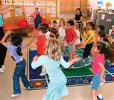
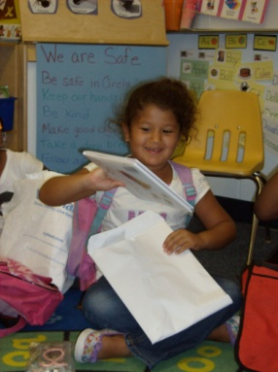
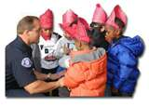
10 Developmental & Learning Areas
4 Developmental Areas 5 Content Areas English Language Learner
Social-Emotional
Physical
Language
Cognitive
Literacy
Mathematics
Science & Technology
Social Studies
The Arts
Receptive
Expressive
Determined by
Home Language Survey
Notes:
Activity –groups of 4 or 5- Give slips of Developmental or content areas. Have group report objectives they would place in selected area. Then select objective and have them report dimensions they would think would be of value.

Slide 10
The Objectives give the assessment process a structure for teachers to organize their observations and encourages purposeful responsive planning.

Slide 11
Notes:
Exercise 1 then Hand Out Booklet

Slide 12
Many Objectives include dimensions
Objective
17. Demonstrates knowledge of print and its uses
Dimensions
a. Uses and appreciates books
b. Uses print concepts
dimensions
Notes:
Dimensions break down the objectives where need to isolate skills and knowledge making it easier to identify or isolate the skill and consistently analyze the facts collected.

Slide 13
INDICATORS- the progression of learning levels 2,4,6 and 8
INDICATORS- the progression of learning levels 2, 4, 6 and 8
The indicators move from simple to complex skills and development.
What skills are clearly and consistently demonstrated by this child?
Each segment separated by a ; must be observed such as the indicator for rating 6.
(The child must demonstrate that they sustain their work and ignore distractions.)
Progression Levels
Not Yet - It is not a reasonable expectation for children at this age to demonstrate this skill.
Not Observed - RARELY USED-only indicated if child has just enrolled or has bee excessively absent
Notes:
It is important to indicate not yet if the child is unable to demonstrate a skill even with support. This establishes a baseline for the child. We will be following growth and development over the infant/toddler/preschool/ K years. Look at an example looking at the progression Of D&L for 1 obj

Slide 14
These skills are just now appearing and not consistent. The competence level is not solid enough to assess the child’s developmental level at the next indicator. The child may need verbal suggestions, physical modeling, an/or visual cues to successfully accomplish the specific objective or dimension.
Vygotsky describes the “zone of proximal development” as the difference between what a child can do on his or her own compared with what the child can do with adult help. With the assistance of an adult, a child will be able to succeed at a cognitive or social learning task beyond what they could accomplish on their own.
Notes:
What would be an example of a child at level 3 for obj 1-c?

Slide 15
¿ How Works ?
Teaching strategies gold progression have color- coded bands that show widely held expectations for children's development and learning. The bands show at what levels most children of a particular age or class/grade.
.
The color bands also overlap, helping teachers guide their expectations realistically and work with any child, at any level of development.

Slide 16
What Do the Color Bands Really Represent?
Notes:
Widely Held expectations

Slide 17
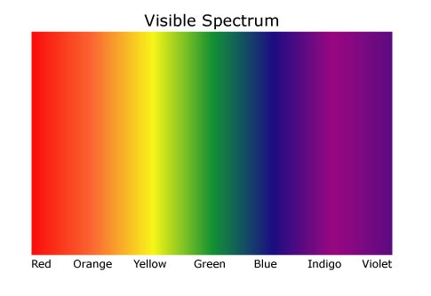
The Color Bands are Widely Held Expectations for Each Age Group
.
The colors in the color spectrum are uneven, blend together and overlap; yet there is a predictable pattern.
The color bands let us know how children
typically develop and learn at different ages. This is critical
for responsive teaching and knowing what is age appropriate.
The length of each band varies for each objective. When they overlap, it is telling us that this skill takes time to develop. Other bands may span across multiple indicators suggesting that this development has several key shifts in learning over the course of the year..
Notes:
Discuss objectives that show different age spans for indicators. If you look at objective 1 a and compare the bands to Objective 15 a You can see this .

Slide 18
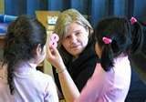
Children’s development is unique and not the same for all. Sometimes a skill does not emerge until a child is 2,3 or 4 years of age and others begin at birth, some skills take along time to develop and others take much less time.

Slide 19
LET’S TRY USING IT WITH A FEW EXAMPLE OBSERVATIONS
Notes:
As you look through the progressions for each objective or dimensions you can see that the structure is laid out for you step by step

Slide 20
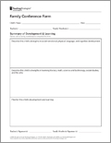
So what about reporting?
Finalizing checkpoints for reporting purposes is a time to pause in the assessment process. You are simply summarizing the information that you will be collecting, analyzing, responding to, planning for & communicating with families on an ongoing basis throughout the year.
Summarize
Plan
&
Communicate
Checkpoints & planning
forms online
Family Conference Form

Slide 21
Let’s Take a Look Online
Notes:
Each child will have their own portfolio

